Slide 1
Qualifying the workforce: the journey we are on
HCTA Members Meeting: March 2025

Slide 2
Strategic direction
Proof of training and qualifications
Improving standards and safety
2 key criteria:
Nationally recognised construction related qualification
CITB Health, Safety and Environment test (or alternative)
Additional requirements expected via the Building Safety Act: include Continuous Professional Development and other forms of training.

Slide 3
Myth busting
A Health and Safety Card x
A passport to gain entry to site x
A legal requirement x
A Standard Setting Body/CITB x
A Training Provider/ CSCS test x
Proof of Identity
Proof of qualifications and training

Slide 4
Notes:
CSCS Alliance
Introduce the CSCS Alliance
Strategic direction firmly focused on the achievement of nationally recognised construction related qualifications
100% in line with the CLC’s recommendation – first published 2015 – 2017 – 2020 and again in 2024
Since 2015 the CLC have continually confirmed cards should only be issued to those who have achieved (or are in process of achieving) a recognised qual for their occupation.

Slide 5
Construction Leadership Council recommendation
Leading the way to a fully qualified workforce
Minimum standard for skilled worker N/SVQ Level 2
Over 500,000 previously unqualified card holders transitioned to a recognised qualification since 2015
Final step is the withdrawal of Industry Accreditation
2024 update acknowledges the Building Safety Act: introduces “additional training” and “competence” – pathing the way for CPD and additional training.
Notes:
CLC recommendation, has led the way towards a “fully qualified workforce”
Potted history on cards withdrawn that did not require a qualification (CSO, CRO and Visitor)
Over 500,000 previously unqualified card holders have transitioned to a qualification since 2015
Last piece of the jigsaw is the withdrawal if IA – 15,000?? Remaining – we don’t need to go into a lot of detail here
Finish off with how the 2024 CLC recommendation acknowledges the Building Safety Act by introducing “additional training” and “competence” – pathing the way for CPD and any other additional training that may be required

Slide 6
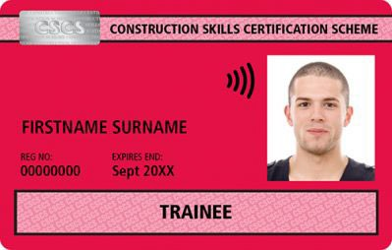
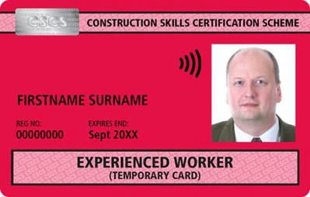
CSCS card types
www.cscs.uk.com/types
*Technical, Supervisory or Management
Provisional
Labourer
Apprentice
Industry Placement
Trainee
Experienced Worker
Experienced TSM*
Academically Qualified Person
Skilled Worker - Blue
Skilled Worker - Gold
Supervisory
Manager
Professionally Qualified Person

Slide 7
Card requirements
CITB Health, safety and environment test pass
at the relevant level within the last 2 years
the test costs £22.50, revision materials are available at additional cost.
Qualification certificate copy / Qualification enrolment evidence
with the exception of the Provisional card
Card application: via CSCS Online / My CSCS
cards cost £36.00, except the Apprentice card which is free

Slide 8
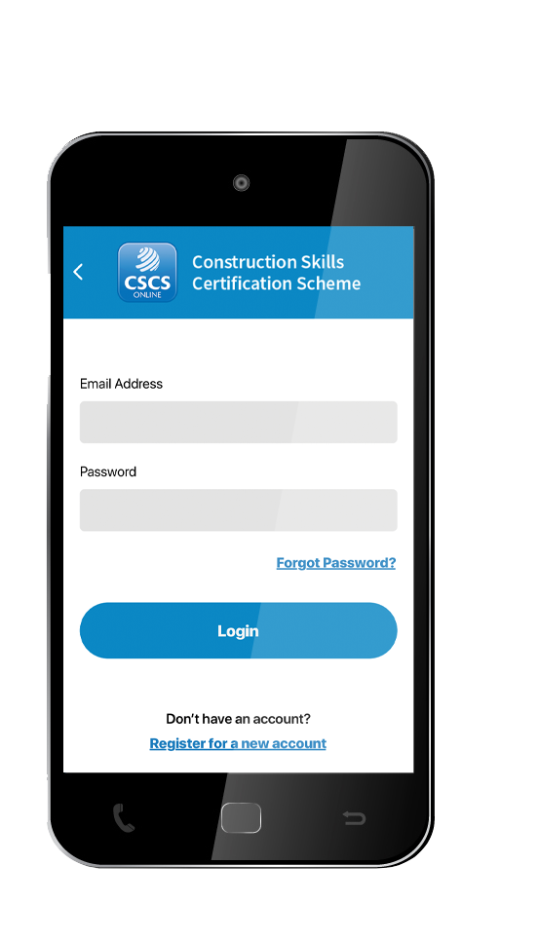
How to apply
There is only one official CSCS application service and we recommend using cscs.uk.com rather than any third party organisations.
To apply for a CSCS card quickly, easily and securely, applicants can visit: cscs.uk.com/apply, or download the My CSCS app for Android or iOS.

Slide 9
Trainee card: Why make the change?
Skills shortage - 50,000 extra workers required each year
Compounded by 120,000 candidates annually taking occupational related non-competence qualifications
Do not meet the N/SVQ Level 2 competence threshold and no site experience
Confusing system, those that remain restricted to the Labourer card
Alignment with the competency expectations of the BSA
New entrants start career on a red card (not Labourer) demonstrating they are on a recognised training pathway.
Notes:
With over 50,000 extra workers required per year to maintain output, construction’s skills shortage is well documented
Further compounded by approximately 120,000 candidates annually undertaking level 2 (or above) non-occupational competence qualifications for construction trades
None of these qualifications meet the industry’s N/SVQ Level 2 occupational competence qualification threshold or provide site experience to be eligible for a CSCS skilled worker card
The system can be confusing and off-putting to new entrants, those that do stay in construction are restricted to applying for the Labourer card (limits training opportunities)
Supports the direction of travel emerging from the Building Safety Act - better aligned with the competency expectations of the Act – pathway to SKEB
Encourage more new entrants to start career on the Trainee rather than Labourer card – show employers they are on a recognised training pathway/supporting long-term career progression.
With over 50,000 extra workers required per year to maintain output, construction’s skills shortage is well documented
Further compounded by approximately 120,000 candidates annually undertaking level 2 (or above) non-occupational competence qualifications for construction trades
None of these qualifications meet the industry’s N/SVQ Level 2 occupational competence qualification threshold or provide site experience to be eligible for a CSCS skilled worker card
The system can be confusing and off-putting to new entrants, those that do stay in construction are restricted to applying for the Labourer card (limits training opportunities)
Supports the direction of travel emerging from the Building Safety Act - better aligned with the competency expectations of the Act – pathway to SKEB
Encourage more new entrants to start career on the Trainee rather than Labourer card – show employers they are on a recognised training pathway/supporting long-term career progression.

Slide 10
Trainee card changes
Traditionally a five-year card, for those registered on a construction related qualification
Becomes available to those holding certain L2 (and above) occupational related non-competence qualifications
Initial card valid for two years
Can be renewed for a further three years – with evidence registered onto N/SVQ or an agreed alternative
Effective from February 1st, 2025.

Slide 11
Labourer card: Why make the change?
Historically a rat run for those seeking entry to site
CITB’s Network Forecast confirms 140k labourers needed p/a
Over 500k Labourer cards in circulation, indicating oversupply
CSCS’s data shows 85% of Labourers do not renew their card
Changes will help track the actual number of active Labourers
Alignment with the competency expectations of the BSA
New entrants start career on a red card (not Labourer) demonstrating they are on a recognised training pathway.
Notes:
CITB’s Construction Skills Network Forecast indicates that approximately 140,000 labourers will be needed annually by 2028
With 500,000 Labourer cards in circulation, there is an oversupply issue
Also, CSCS data shows 85% of Labourers do not renew their card, employers highlight many leave the industry long before cards expire
By reducing the Labourer card’s initial validity to two years, we can better track the actual number of active Labourers in the sector
Supports the direction of travel emerging from the Building Safety Act - better aligned with the competency expectations of the Act – pathway to SKEB
Encourage more new entrants to start their career not on the Labourer card, but on one of CSCS’s red cards, demonstrating to employers that the card holder is on a recognised training pathway.

Slide 12
Labourer card changes
Traditionally a 5-year card, intended only for Labourers
Initial card reduced to 2 years
Returns to 5 years on renewal, requires evidence of employment in a labouring role
CITB HS&E test extended to three years, allowing it to be used for renewal - removing financial/admin burdens for genuine Labourers
Effective from February 1st, 2025.

Slide 13
Summary
Several changes since 2015 – all reflecting the needs of industry
Historically 80% of cards issued did not require a qualification
Today 95% of cards require a qualification or registration
CSCS is adapting again to meet the needs of industry - Building Safety Act
No longer about having qualifications and a health and safety test but a culture of the ongoing development of SKEB
Labourer/Trainee card changes align with the competency expectations of the BSA: placing workers on recognised training pathways.
Notes:
Slide 8: Summary
CSCS cards have gone through significant changes over the last 10 years – changes that reflect the needs of the industry
Historically 80% of cards issued did not require the holder to achieve a qualification – only the HS&E test was required
Today 95%??? of cards issued require the applicant to hold (or be registered for) a recognised qualification – this is in response to the CLC’s recommendation first published in 2015
In response to the Building Safety Act the card scheme is adapting again to support the industry
Soon, it will no longer just be about having qualifications and a health and safety test but include a culture of the ongoing development of Skills, Knowledge, Experience and Behaviours
Those elements of SKEB which can be assessed will be reflected on the relevant CSCS card and verified on site via CSCS Smart Check.

Slide 14
Questions

