Slide 1

HCTA AGM – Chair’s Report
11th March 2025

Slide 2
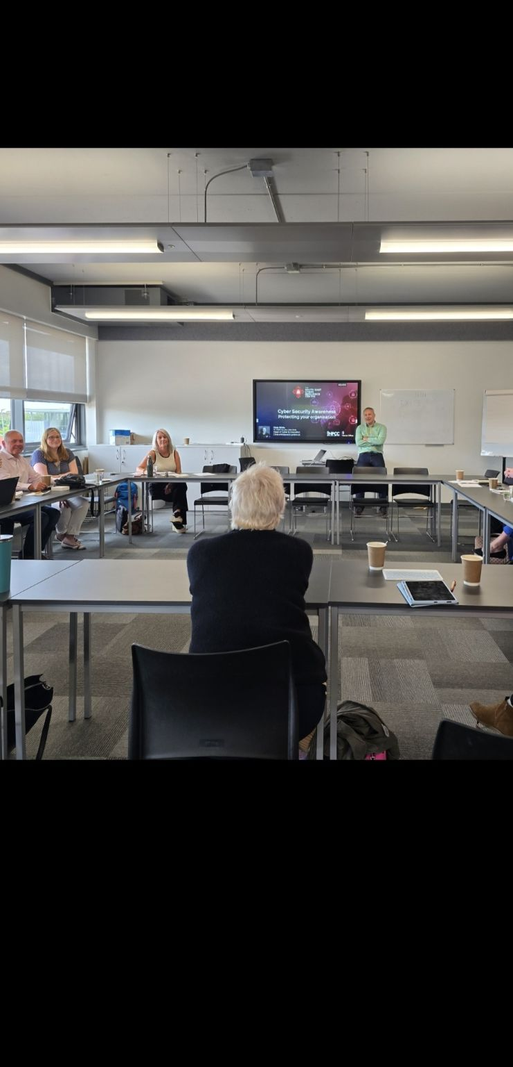

HIGHLIGHTS FROM 2024
Successful 3rd year of our i-construct two-day event with lots of support from member companies and local schools.
Presentations from our members on what they and their company do!
Lively meetings with interesting speakers on a variety of topics.
Updates and feedback from our local CITB advisors.
Networking & sharing best practice with our friends and fellow members.
Creation of the HCTA videos to encourage new members.
More meaningful interactions on LinkedIn following the committee’s excellent Social Media training session with Alex Abbott.
We plan to continue this throughout 2025!

Slide 3
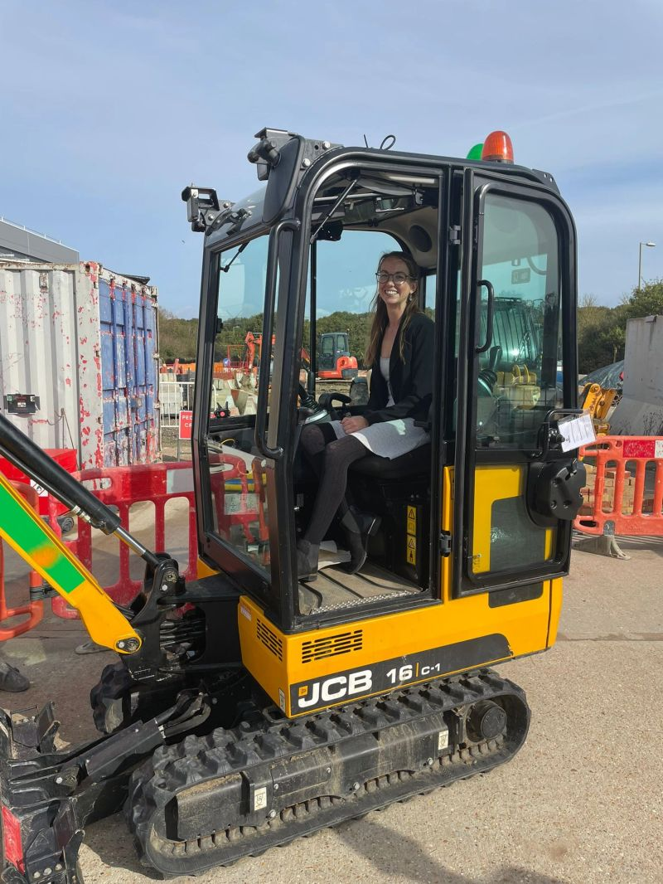
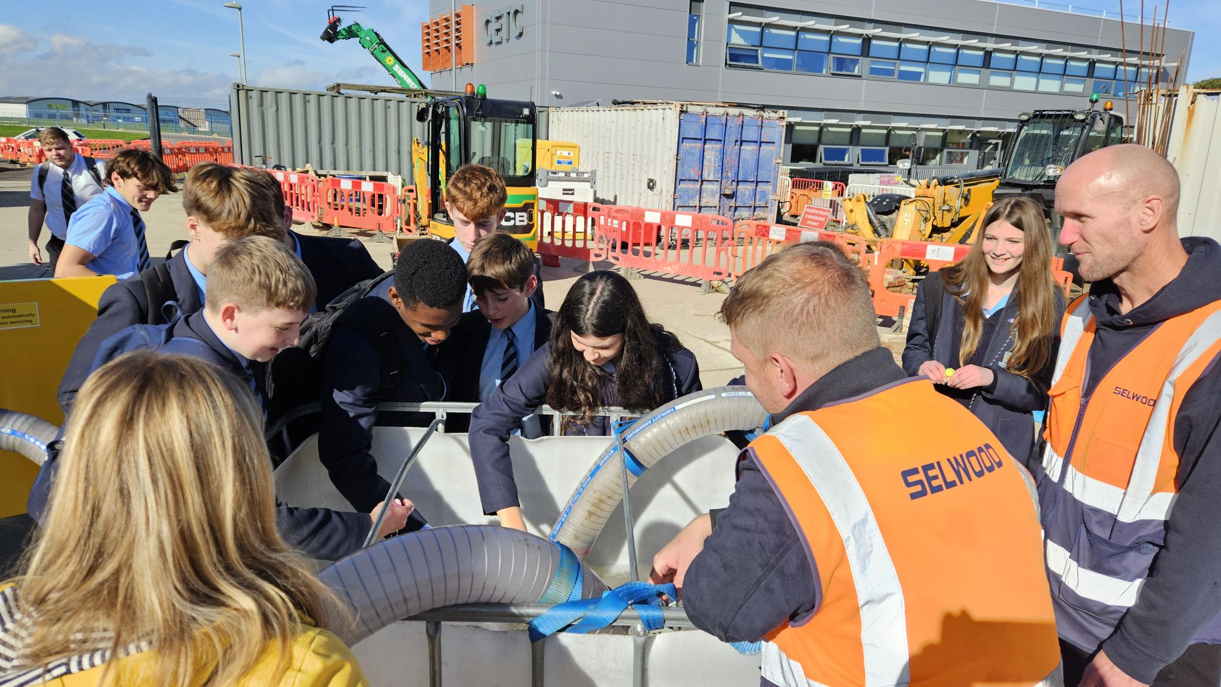
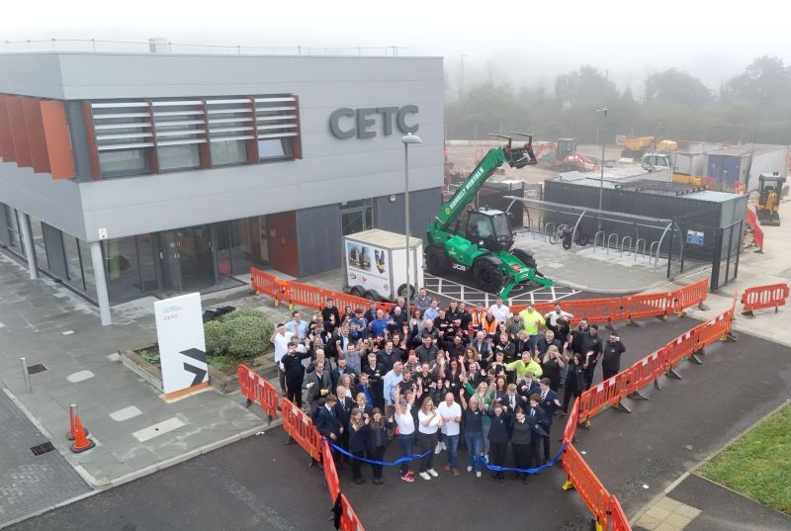
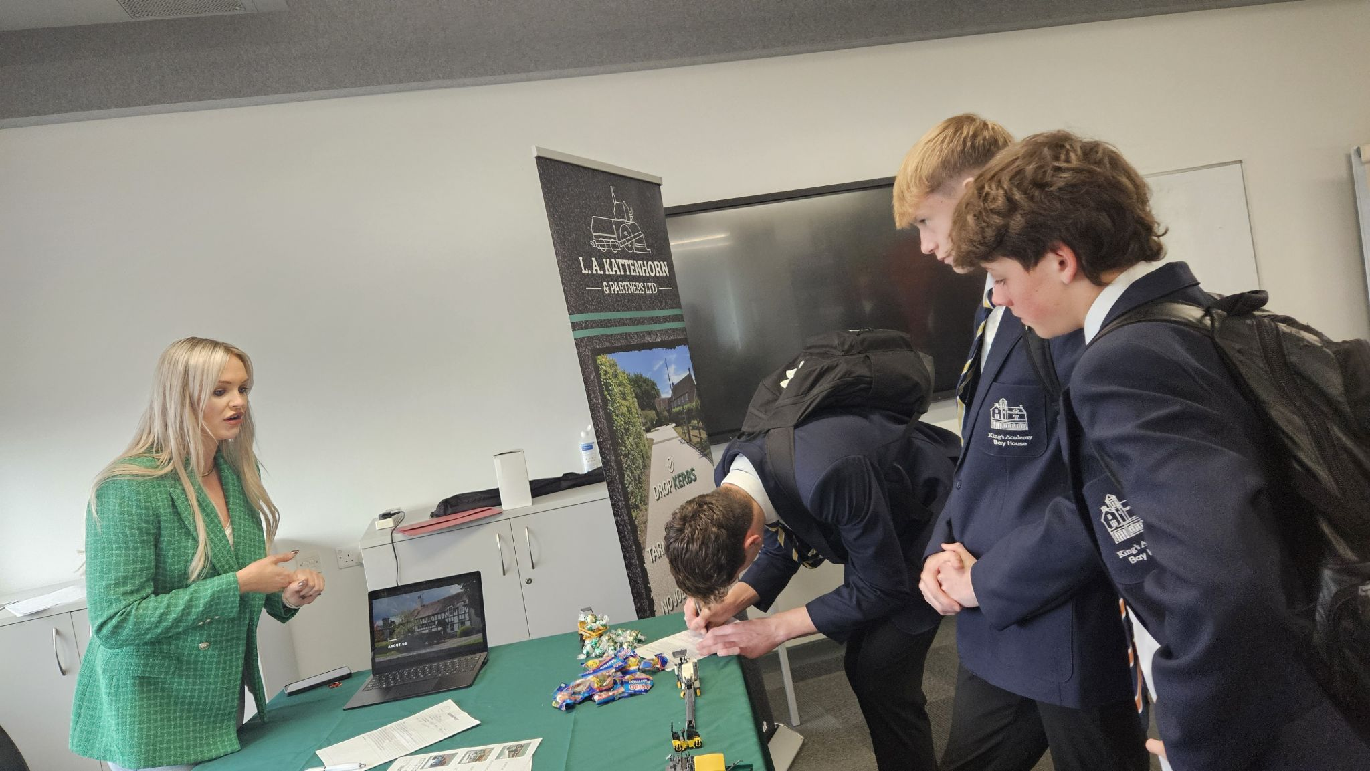
A few snaps from I-Construct 2024

Slide 4
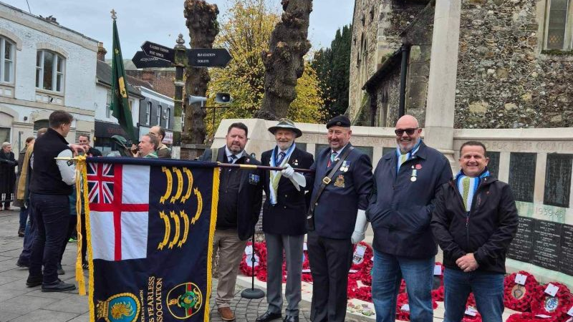
The HMS Fearless Standard. Remembrance Day 2024. Havant

Slide 5
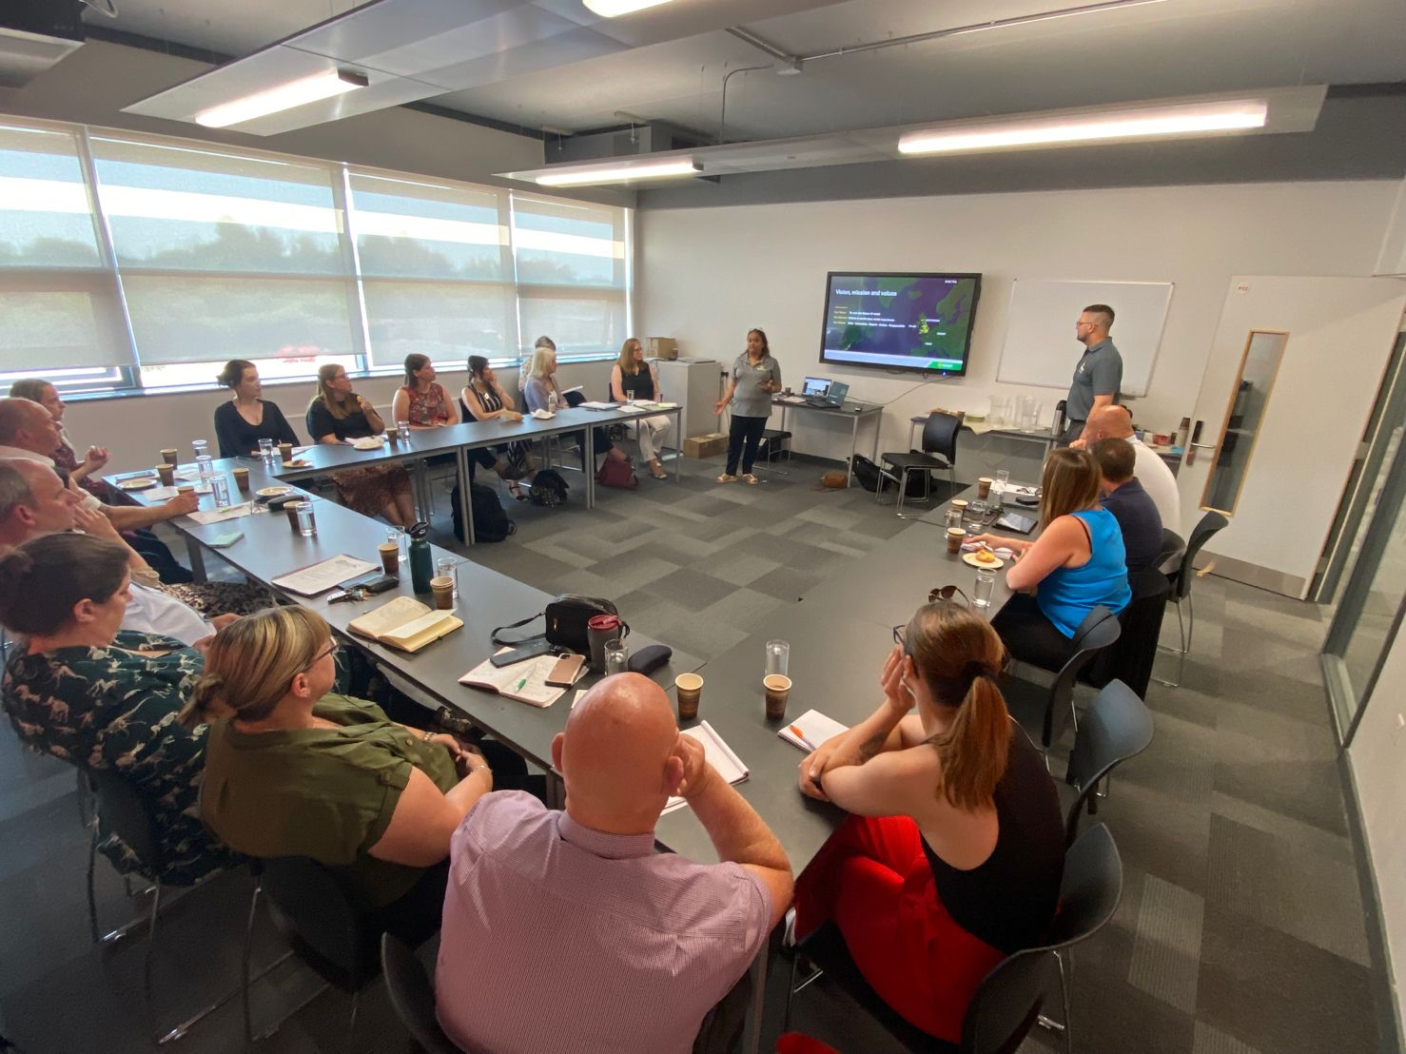
REVIEW OF THE YEAR
March – 2024
Luke Parker attended the meeting to video us all for our Social media platforms and HCTA video
Building Heroes Education Foundation – Nicola Schneider
June – 2024
Social Media for Business - Monique Wintle Camp Coaching
Cyber Security in Business – Chris White - Head of Cyber & Innovation South-East Cyber resilience Centre
Chris Bradshaw L&D manager – RW Armstrong – What does my company do and where do I fit in?

Slide 6
Review of the Year
September 2024
Kate Golding - Suicide Prevention Month
Chris Cunningham – Skills & Employment Funding Bootcamps for Construction Hampshire County Council
Cat Brook & Andy Dodson – Apprenticeships – Solent University
Gavin Vythelingum - Kier – What does my company do and where do I fit in?
December 2024
December – special Secret Santa!
Special Guest Speaker – Dylan Skelhorn – Safety Up
Christmas Quiz and festive lunch

Slide 7
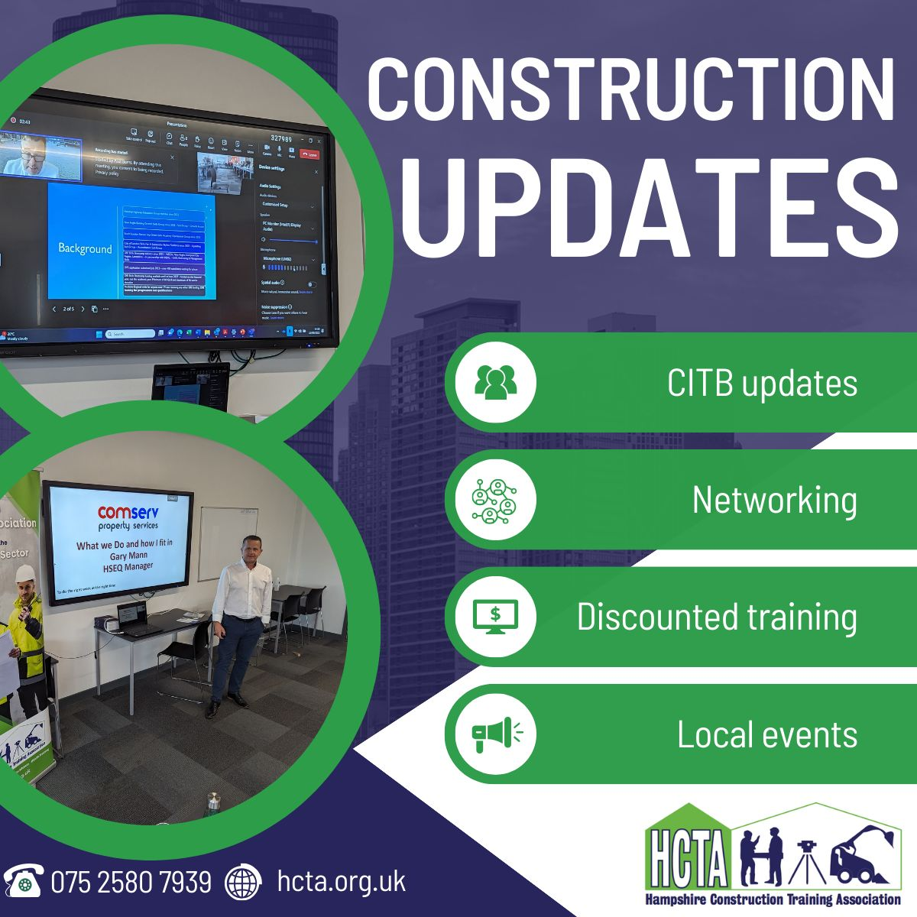
HCTA FOCUS 2025
We will continue to……
Support the i-construct event and encourage young people to consider the construction industry as their career.
Invite informative and enlightened speakers to our meetings.
Make our four annual meetings a great space for networking, sharing of ideas and excellent business practice.
Discuss and highlight the hot topics of the day – Social Values, Wellbeing & Mental Health, our green agenda, skills enhancement and careers.
Be available to offer guidance, support and advice.
Deliver bespoke training as guided by the needs of our members.
Encourage new members
Be more visible on Social Media

Slide 8

And finally, our theme and focus for 2025!

