Slide 1
HCTA March 2023 Solent LEP Skills and Careers Hub Darren Coventry

Slide 2
What is a Careers Hub?
Careers Hubs drive progress against the Gatsby Benchmarks by enabling schools and colleges and their Careers Leaders to access training and support, and to collaborate in a focussed way, bringing together best practice and local labour market insight.
Hubs offer schools and colleges dedicated support from the local hub team and facilitate partnerships with employers committed to improving careers across an area.
The goal is to make it easier for schools and colleges to improve how they prepare young people for their next steps.
(New Forest, Eastleigh, Southampton, Central Solent, Portsmouth, IOW)
There are 41 Hubs in England.

Slide 3
Careers Hub
Strategic Hub Lead
APRIL 2023
Employer Engagement
Operational Hub Lead
Isle of Wight
Eastleigh and New Forest
Central Solent
Portsmouth
S’hampton

Slide 4
Solent LEP Network
104 Establishments (Schools, Colleges, SEND, PRU)
94 Engaged
65 Enterprise Advisors
Less than a third of schools have a full time dedicated careers leader
60% do not know exactly what they can and cannot expect from employers.
Only 1 in 3 establishments have a governor with oversight of careers.

Slide 5
Forming a Solent strategy
Steering Group
Solent Providers
(July 2022)
Solent Skills Advisory Panel
(May 2022)
LSIP from 2024
Cornerstones Employers
Solent Employers
(August 2022)
Gatsby Benchmarks
Provide governance for the SLEP careers hub
Promote partnership and cross region collaboration
increase the quality of local-level skills and labour market
strengthen links between local employers and skills providers
Support Careers education
Inspire our young people to enter industry
Recruit support from industry

Slide 6
Priorities 2022/23
Employer enrichment within careers (EA, supporting curriculum, teacher/CL encounters) – PROGRESSION and CURRICULUM
Parents and influencers understanding opportunities for their young people – how can we educate parent(s) to have a meaningful conversation with their young people about next steps?
SEND and Neurodiversity support – translate the SEND national review and how SEND provision can obtain meaningful support
Work Experience and Enterprise Advisors – increased collaboration
Employability skills and next steps – Parents, students and teacher.

Slide 7
Hub Projects
SEND Inclusion
SEND employer mental health training (PCC to pilot)
Isle of Wight Project – Digital Work Experience Space
Careers Leaders and Enterprise Advisor events
NEET intervention and support (Yr10 and Yr11)
Apprenticeship and Technical Education Pathways for EHE
Apprenticeship and Technical Education Pathways – Digital Yr 8 and Yr 9
Schools Competitions – Construction and Civil Engineering, Digital Contingency, Coding

Slide 8
Enterprise Advisors
Currently there are 94 engaged schools and Colleges with the Hub
65 of them have an Enterprise Advisor
Of these 50% actually help support curriculum design and delivery in schools
Talk to one about what they get from it?
Enterprise Advisers are professionals from any industry, including HR, who volunteer to work directly with a school or college to develop a strong careers programme and help create opportunities for young people. - CIPD

Slide 9
Collaboration
How does a young person learn how to launch a satellite when from a home with generational unemployment
Does a year 10 child with low attendance understand ‘second chance’ and in employment re-training…. Is there life beyond low maths and English achievement?
How to support a parent/influencer understand apprenticeship opportunities in construction?
Only 4% of site managers are female, how do you increase this (£50k+ pa role)?
How many members of your senior leadership structure did not go to university? However they have a level 5 or above qualification gained via employer investment?

Slide 10
Careers and Skills
OFSTED – Thematic review of Careers Advice and Guidance in 2023 for reporting in August 2023.
‘Careers Guidance System in England’ (DfE and DWP -
- Nine Strategic Principals to address ‘particular issues within the existing infrastructure.
- Rationalising of offer to include NEET and EHE – many stakeholders and focus is confusing at times (LA’s, DWP, NCS, DfE, CEC etc etc)
Adult Careers Advice for adults in work and planning for long term careers.
Primary Careers advice and guidance for curriculum
LSIP
The Skills and Post-16 Education Act 2022*
Skills for Jobs: Life Long Learning*
Schools White Paper* - every school to be in or in the process of joining a trust by 2030.

Slide 11
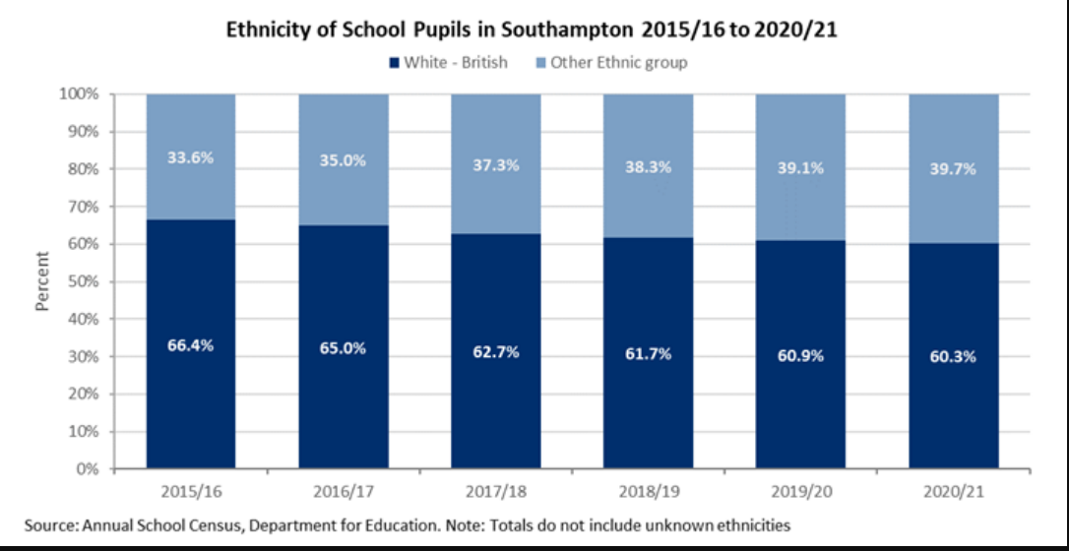
Hard to Reach Groups
As an organisation are you set up to support someone, in the workplace, who has autism/ADHD/other cognitive barriers?
Do you use third party providers for staff CPD around ?
Do your organisation have any inclusive recruitment practises?
How do you connect with BAME communities? Or groups where English is not the language spoken at home?
Ethnically Diverse Peer networking (solentlep.org.uk)

Slide 12
Employability/Soft Skills
What are the biggest concerns/issues that you have with the standard of applicants that are coming to you for:
Work Experience
Apprenticeship
Entry Level roles
How can schools address this and prepare young people better for next steps?
How can industry support this? Does your organisation support with any of the following?:
- Mock interview days
- Industry readiness
- Health and Safety and how this dictates workplace practises?

Slide 13
Immersive Experiences
Women in STEM – Ocean infinity
Maritime as a sector of opportunity (land v sea)
Finance – the importance of money
Digital – Apprenticeship and Technical education pathways within the digital world
NHS – 350+ programme – Solent LEP is the largest sponsor
Creative – University of Portsmouth
IN PROGRESS – One Horton Heath.

Slide 14
Teacher Encounters
Invite teachers into your workplace with teacher encounters
Do you want to ensure young people in education know about your industry and the skills needed to thrive in your business?
Are you keen to help teachers stay up to date with your industry and bring this to life in their lessons?
Inviting teachers into your workplace for a few hours, a few days, or even longer has benefits for your business, for teachers, and importantly, for the young people that will form the workforce of the future.
What is a teacher encounter?
A teacher encounter provides an opportunity for teachers to engage directly with employers to see and learn about the different career pathways relevant to their subjects, and to observe how their subject is applied practically in business.
There are a number of pathways and routes into employment, in particular technical and vocational options like apprenticeships. This knowledge can empower educators to effectively support students to take their best next step.
Teacher encounters can take many forms, from two hours to multiple days, face-to-face, virtual or a mix of both. From just one teacher to multiple colleagues.

Slide 15
Thank You
Any questions?
Or better still, any offers of support?

