Slide 1

Carbon Management In The Built Environment
Dan Hill-Morriss
Head of Sales
Carbon Footprint Ltd

Slide 2
Agenda
Introduction to Carbon Footprint
Climate change & why it is important that we take action to address it.
What businesses can do – PAS2080 Carbon Management in Infrastructure.
Offsetting unavoidable emssions

Slide 3



Introduction to Carbon Footprint Ltd
A family owned and managed business focused on providing Climate Change Solutions
Been helping organisations reduce & offset emissions for about 17 years
Host and manage the most popular carbon calculator on the internet
Have supported around 100 carbon reduction projects around the world
A founding member of the Quality Assurance Standard for carbon offsetting
Regularly asked by the BBC and other media to provide Expert comment on Climate Change Solutions and Carbon Offsetting
We are one of the most trusted Climate Change Solutions providers in the world. Selected by The Committee on Climate Change, The UK Government, councils, cities, multinational companies, universities and SMEs

Slide 4
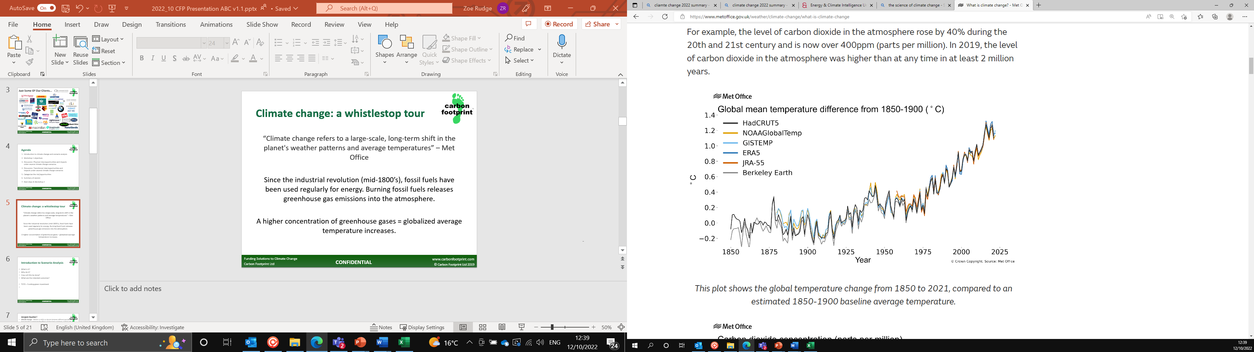
What is climate change?
“Climate change refers to a large-scale, long-term shift in the planet's weather patterns and average temperatures”
– UK Met Office
Source: Met Office

Slide 5
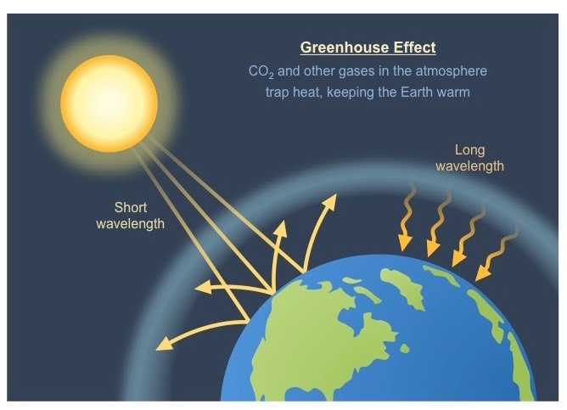
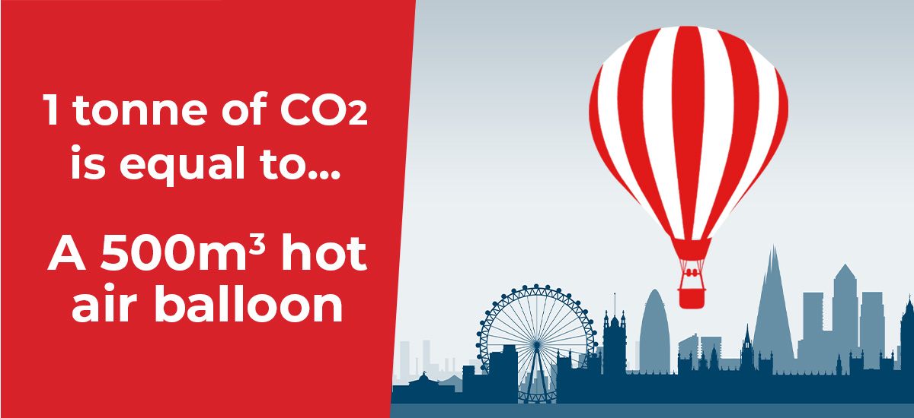
What is climate change?
This is driven by anthropogenic GHG emissions, driving the greenhouse effect and leading to climate change.
Emissions are measured in metric tonnes of carbon dioxide equivalent (CO₂e).
Humans have already caused a global average temperature rise of approx. 1.1°C relative to pre-industrial times.

Slide 6
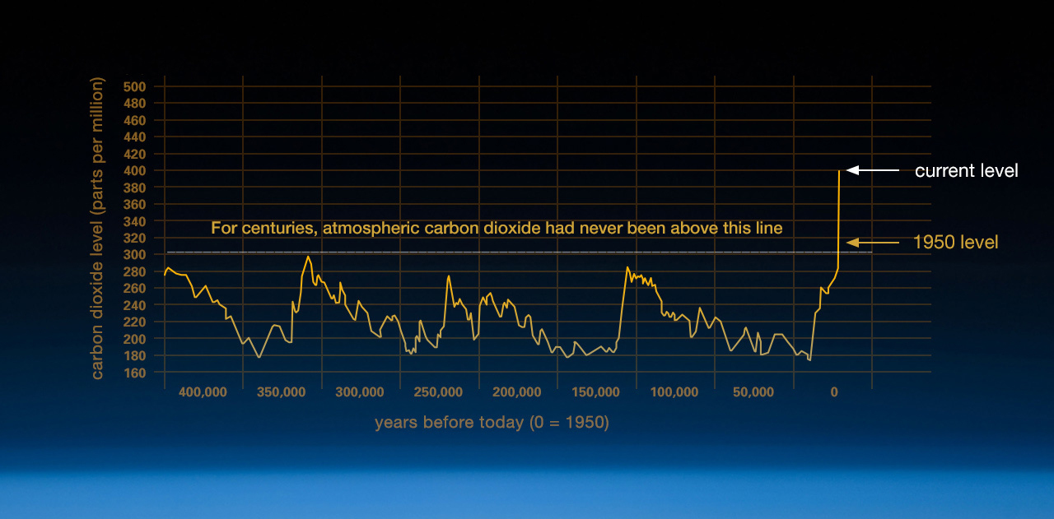
Current position
The climate crisis presents the “biggest threat to security that modern humans have ever faced”, Sir David Attenborough
Source: NASA Climate Change: Vital Signs of the Planet (nasa.gov)

Slide 7
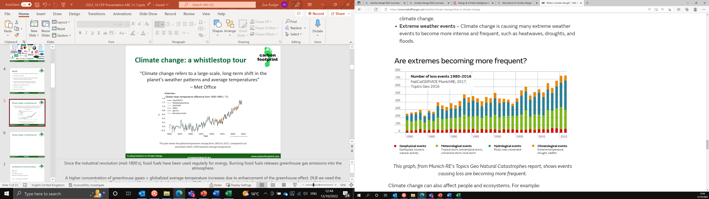
Impacts of climate change
“It is unequivocal that human influence has warmed the atmosphere, ocean and land. Widespread and rapid changes in the atmosphere, ocean, cryosphere and biosphere have occurred.” – IPCC, 2021

Slide 8
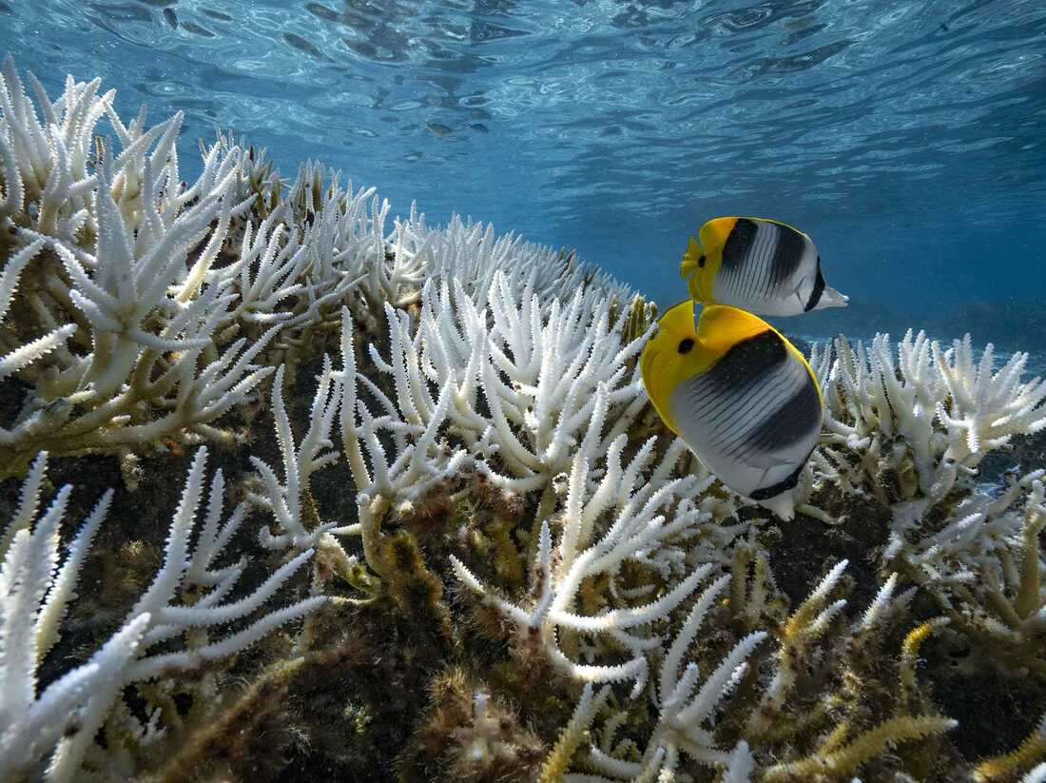
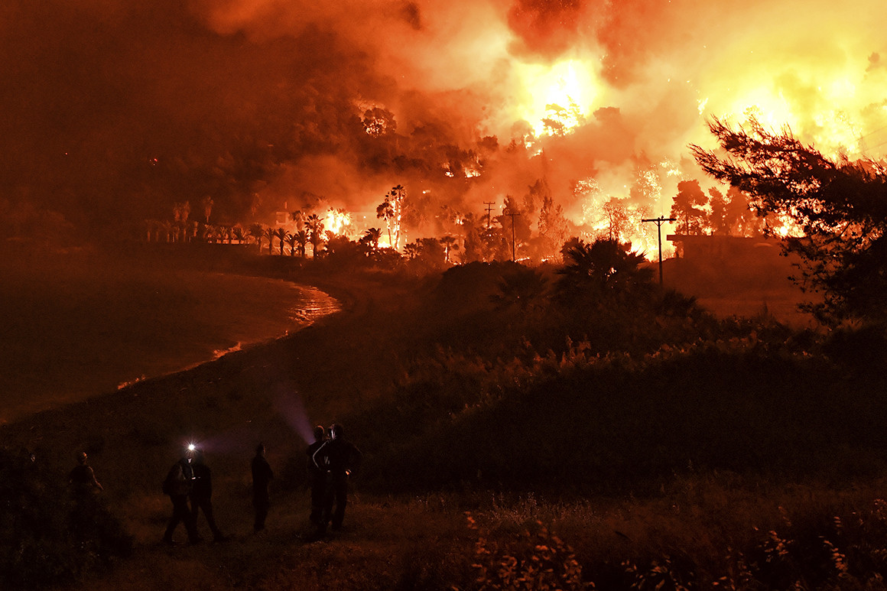
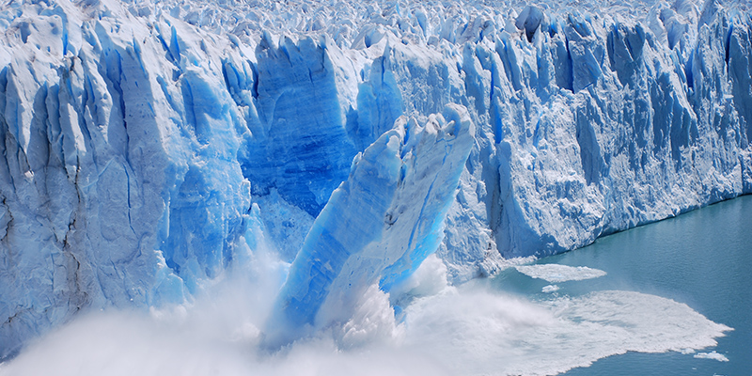
Impacts of climate change
Some examples include…
Habitat loss & desertification
Ocean acidification
Glacial retreat – artic sea ice thinning & retreating
Sea level rise
Extreme events – more frequent and intense
  flooding, hurricanes, forest fires, etc.
Increased frequency of forest fires
Change in migration patterns
  – including disease vectors e.g. mosquitoes!

Slide 9
Paris Agreement 2015 was signed at COP21 (2015)
The Paris Agreement is a legally binding international treaty on climate change.
Adopted by 196 countries.
Its goal is to limit global warming to well below 2°C, preferably to 1.5 °C, compared to pre-industrial levels.
The Paris Agreement works on a five- year cycle of increasingly ambitious climate action carried out by countries. Every five years, each country is expected to submit an updated national climate action plan - known as Nationally Determined Contribution (NDC).
Aims to provide finance for developing nations for mitigation, resilience.

Slide 10
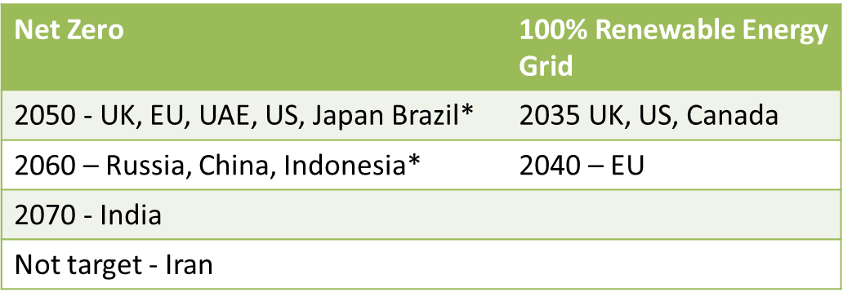
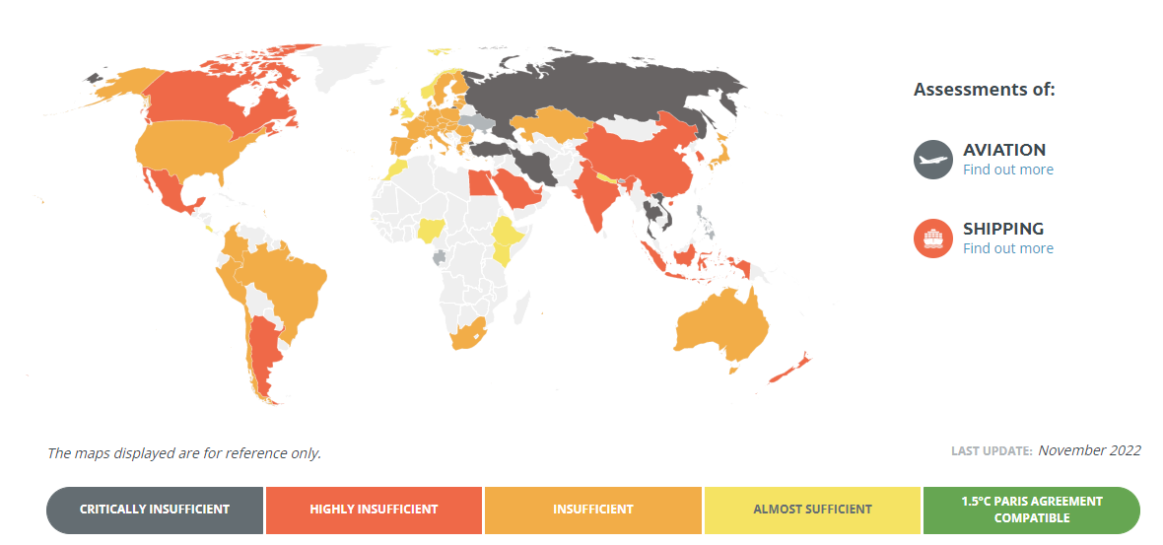
Current global targets
No countries overall actions are in line with limiting global warming to 1.5 °C.
We must do more and quicker.

Slide 11
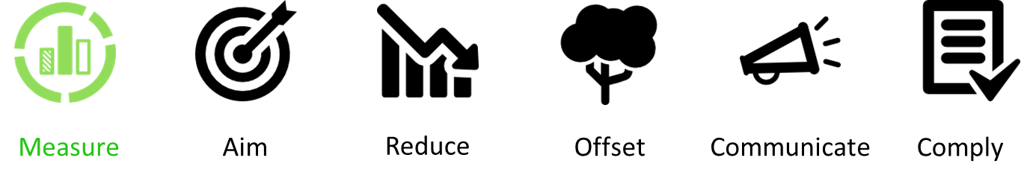
What can businesses do?
Quantify current carbon footprint
Offset emissions
Create an action plan and set net-zero targets
In order to avoid the most severe impacts of climate change and limit global warming to ‘well below 2ºC and ideally 1.5ºC’ emissions need to:
Peak by 2025 to reduce by 45-50% by 2030
Reach ‘Net Zero’ by 2050
IPCC 6th Assessment Report 2022

Slide 12


Slide 13
What can businesses do?
Following the Infrastructure Carbon Review in 2013 it was identified that infrastructure is responsible for over 50% of the UK’s carbon emissions therefore PAS 2080 was designed to specifically address the management of carbon in infrastructure.
It looks at the whole life cycle of the carbon used on projects and promotes reduced carbon, reduced cost infrastructure delivery and a culture of challenge in the infrastructure value chain where innovation can be fostered.
The BSI verification scheme supports clients in industry by assessing your delivery of projects to PAS 2080 requirements, your measurement and monitoring of carbon against the delivery of a project, and the management of your supply chain, or your role within it.
Demonstrate your commitment to carbon reduction in the marketplace
Measure and monitor carbon reduction
Collaborate on projects across the supply chain
Gain a competitive edge when bidding for tenders

Slide 14

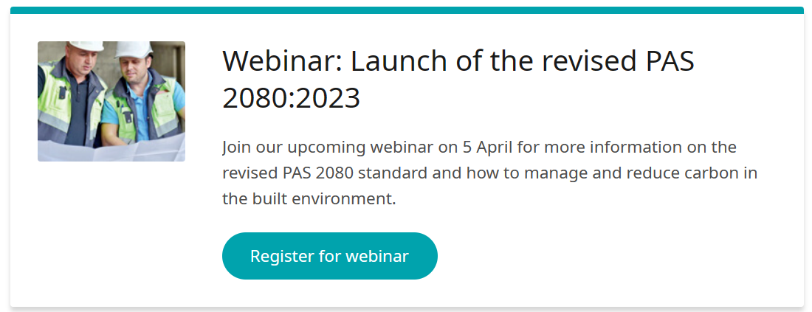

Slide 15
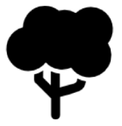


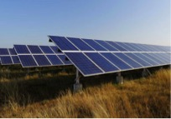
Carbon Offsetting:
The ability to address climate change NOW.
Reduce global carbon emissions to compensate for the emissions caused by your business.
Projects which support communities in developing countries, to align with any CSR strategy.
Projects which introduce biodiversity and preserve critical eco systems.
Projects which provide renewable energy solutions to remove the need for fossil fuels to provide power.
Hundreds of projects – build a portfolio to balance your CSR values with your carbon reduction budget.
Be a part of the solution NOW, whilst continuing toward your goals to reduce emissions at source.
*CSR = Corporate and Social Responsibility

Slide 16



Carbon Offsetting:
The ability to address climate change NOW.
The Quality Assurance Standard (QAS) is a comprehensive independent audit system.
QAS-approved products are checked against a 40 point checklist to ensure they meet the very highest standards in the world.
Carbon Footprint Ltd was one of the first companies to achieve QAS Approved carbon offsets
https://qascarbonneutral.com
In addition to this, the majority of projects that we recommend will be approved by either the Gold Standard or the VCS (Verified Carbon Standard) for carbon offsetting.

Slide 17











































Just Some Of Our Clients…

Slide 18
References and useful resources
Sixth Assessment Report — IPCC
What Is Climate Change? | United Nations
Ambitious corporate climate action - Science Based Targets
ISO - Net Zero Guidelines
2020 UK Greenhouse Gas Emissions, Final Figures (publishing.service.gov.uk)
The Paris Agreement | United Nations
Emissions Infographic (theccc.org.uk)
Greenhouse gas reporting: conversion factors 2021 - GOV.UK (www.gov.uk)
Greenhouse Gas Protocol | (ghgprotocol.org)
ISO - ISO 14064-1:2018 - Greenhouse gases — Part 1: Specification with guidance at the organization level for quantification and reporting of greenhouse gas emissions and removals

