Slide 1
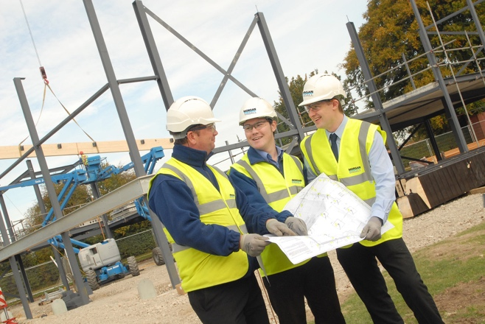

CITB Update – HCTA Meeting
20th September 2022

Slide 2
New Plant Grants
The changes will start being introduced in January 2023. The new standards will ensure safe, consistent and high-quality plant operations throughout England, Scotland and Wales.
The first phase of the changes will see new standards introduced for the following:
Excavator 360, above 10 tonnes (tracked)
Forward tipping dumper (wheeled)
Rear tipping dumper/ dump truck: articulated chassis (all sizes)
Ride on Roller
Telescopic handler: all sizes excluding 360 slew
Industrial forklift
Plant and Vehicle Marshaller
Slinger, Signaller: all types, all duties

Slide 3
Alongside the new standards, the grant rates for plant training and tests will also be changed and improved.
Currently, three smaller grants are available for practical test, theory test and short course training, which employers can claim in different ways.
Under the new changes a larger single grant will be available for all CITB registered employers. To claim grant, employers will only need to give their CITB registration number to the Approved Training Organisation (ATOs) delivering the training and testing.
By making these changes we aim to make claiming grant for plant training and testing simpler and straight forward for employers.
Training related to the new standards from January 2023 will only be grant eligible if it meets the following criteria:
Is delivered by one of CITB’s Approved Training Organisations (ATO)
Is quality assured by the provider, the card scheme and CITB
Leads to a CSCS card

Slide 4
Current grant rates and the expected grant rates for the eight new standards are detailed below:
Tier 1
Current training rate: £120
Current CPCS testing rate: £250
Maximum rate claimed: £370
Proposed Novice Rate: £440
Proposed Experienced Rate: £370
Tier 2
Current training rate: £120
Current CPCS testing rate: £300
Maximum rate claimed: £420
Proposed Novice Rate: £500
Proposed Experienced Rate: £420
Tier 3
Current training rate: £120
Current CPCS testing rate: £470
Maximum rate claimed: £590
Proposed Novice Rate: £700
Proposed Experienced Rate: £590

Slide 5
Leadership and Management Modules
11
New Standards
11 new CITB Assured Standards
Inspired by the Construction ILM (C-ILM) qualification
Aimed at Construction Supervisor level
Launching 1st April 2022 – Initially as Standards in Development (SID’s)
Tier 2 & 3- £70 - £120 Grant
Available to any sized employer
Employers can ‘pick and mix’ individual courses to suit the needs of their workforce
Only delivered by CITB ATOs

Slide 6
Standards
Launched as SIDs
Leadership and management practice in Construction
Delivery of site operations and logistics
Achieving performance through people
Understanding commercial awareness
Handling difficult situations
Understanding training and coaching in construction
Understanding, organising and delegating in construction
Planning and monitoring work in construction
Solving problems and making decisions
Developing yourself as a team leader
Understanding the recruitment and induction of new staff
Full Standards - Summer 2022
Fairness, Inclusion, Respect

Slide 7
What’s new for 2022 - 2023
What’s new for the 2022-2023 Grants Scheme
New and increased grants from 1 April 2022
CITB has increased the amount of money available through grants this year and introduced new grants. This is to help tackle the skills shortage in the construction industry.
Increased grant for dry lining apprenticeships
You can now receive an additional £2,000 on top of the existing grant (£2,500 per year for attendance and £3,500 for achievement) for dry lining apprenticeships that start from 1 April 2022 onwards.
Increased grant for rainscreen cladding VQ achievements
For achievements dated from 1 April 2022, you will receive an additional £400 on top of the existing £600 grant for employees successfully completing a rainscreen cladding VQ.
Leadership & Management short course grant
From 1 April 2022, you can now receive a grant of £70 for each Leadership & Management short course standard achieved through an approved training organisation (ATO). The ATO will apply for this grant on your behalf.
CITB Occupational Traineeship (England Only)
A £1,000 grant is available for the completion of a CITB Occupational Traineeship in England.

Slide 8
Leadership & Management direct delivery tender launch
CITB is launching a new commission on the 22nd September 2022.
The commission intends to fund 10,500 newly C-ILM qualified Construction front line managers by providing free access to 5 ILM modules to attain a level 3 certificate in Leadership and Management Practice for the Construction and Built Environment Sector, with a budget of £10.5M.
# this event will be recorded

Slide 9
Thank You
Jacquee Say Engagement Adviser for Solent & IOW jacquee.say@citb.co.uk tel: 07917 556997
Liz Steel Customer Engagement Manager liz.steel@citb.co.uk tel: 07768 003933
Natalie Sprake Engagement Adviser for North Hampshire Natalie.sprake@citb.co.uk tel: 07768 178124

